Slide 1
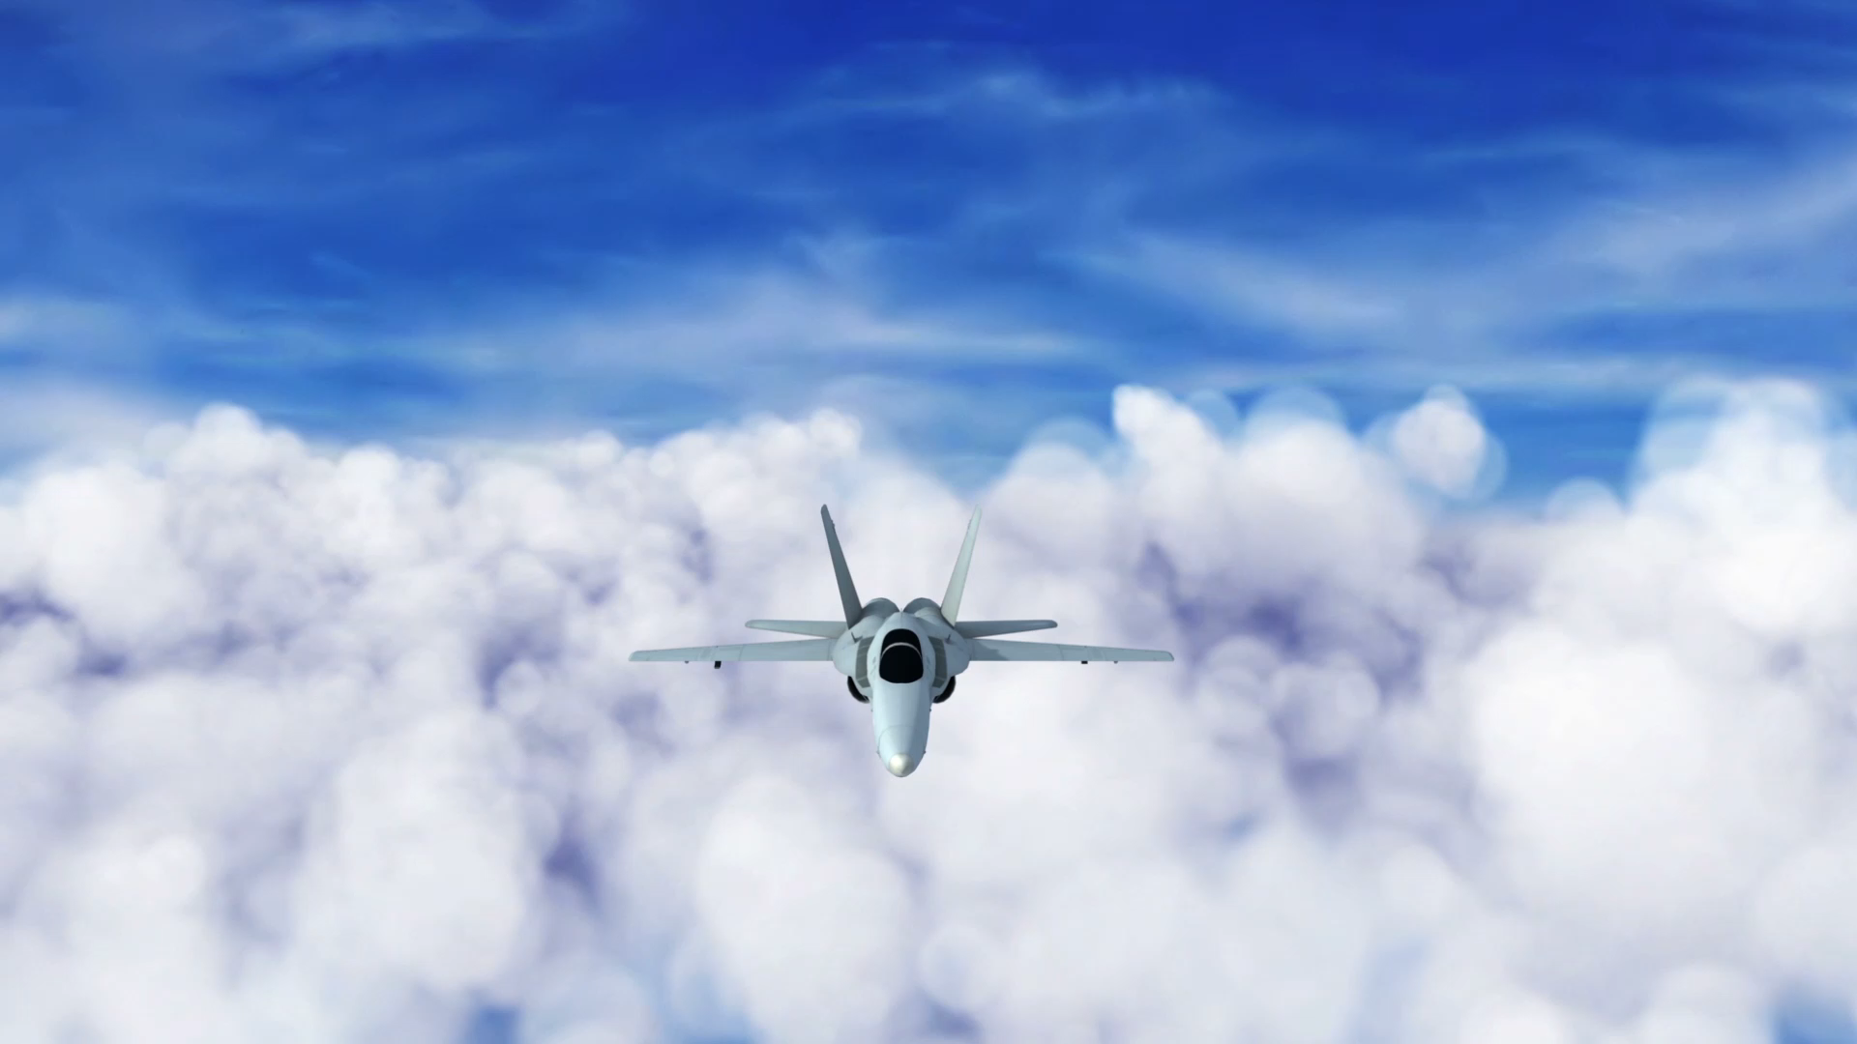
Pilot Success
Jake Rose, Andy O’Brien, Stacey Smoot

Slide 2
Background
The Leadership In Flight Training (LIFT) Academy offers pilot training programs including a direct classroom-to-cockpit opportunity. Working with Republic Airlines, LIFT Academy training has the potential to advance to Captain. The programs are tailored around each student’s schedule.

Slide 3
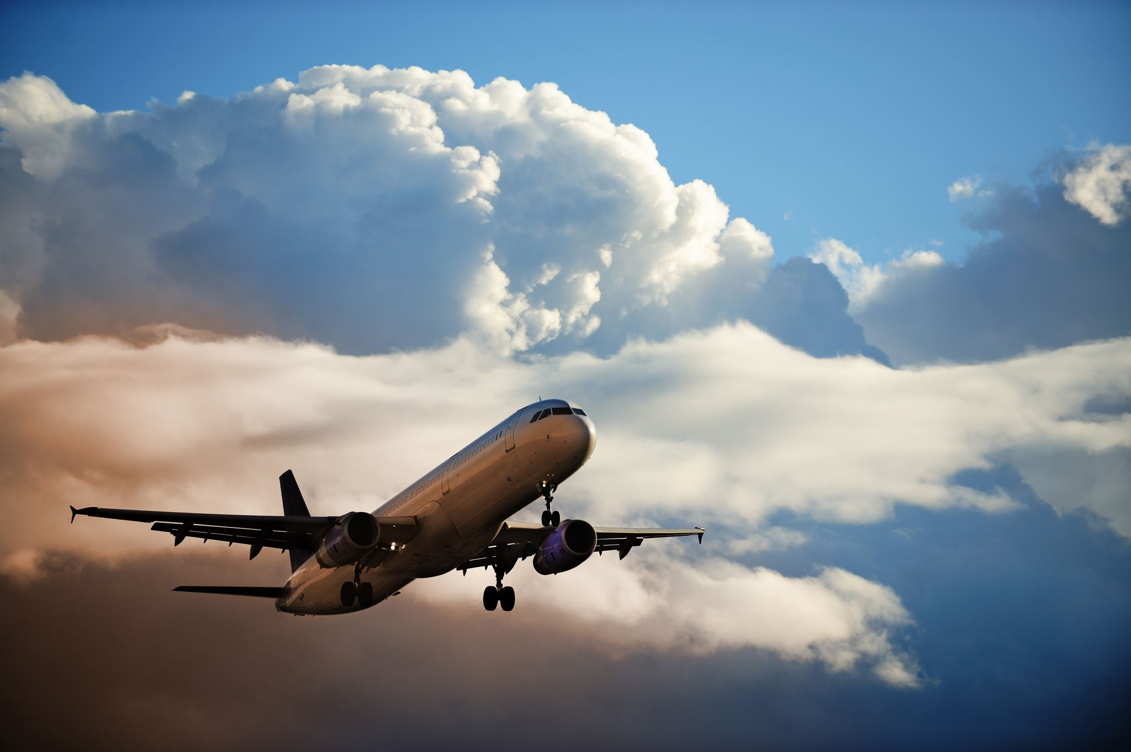
"Without the pilot, there is no flying from one place to another."
- Lailah Gifty Akita.

Slide 4
Prediction and Goal
Using real data from Lift Academy to determine a student’s flight hours based on days spent within the course. This will be used to predict time requirements for new students and cost per student for the company. In the future, additional information can be added to this to determine how much time it will take a multicourse student to complete all necessary training to become a trainer or move to domestic/national flight captain.

Slide 5
Data and Cleaning
Start
Start with Graduate Roster
Add
Add columns: Course Count, Start Month, Target Hours, Target Days
Calculate
Calculate: Variance Hours, Variance Days
Initiate
Initiate machine learning

Slide 6

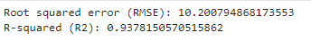
Machine Learning
Supervised Multiple Linear Regression
Features: Course Short Name, Start Month, Course Flight Hours, E2E Course Days Course Count
Target: Course Flight Hours

Slide 7
Code
Libraries Used
- Pandas
- Matplotlib
- numpy
- sklearn
https://github.com/JakeRose689/Pilot-Success

Slide 8
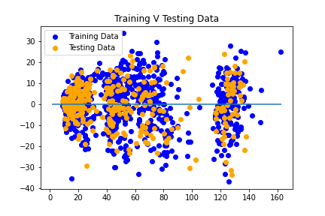
Outcome
The model is successful and can reasonably predict how profitable a student can be within a class.

Slide 9
Heroku
Details

Slide 10
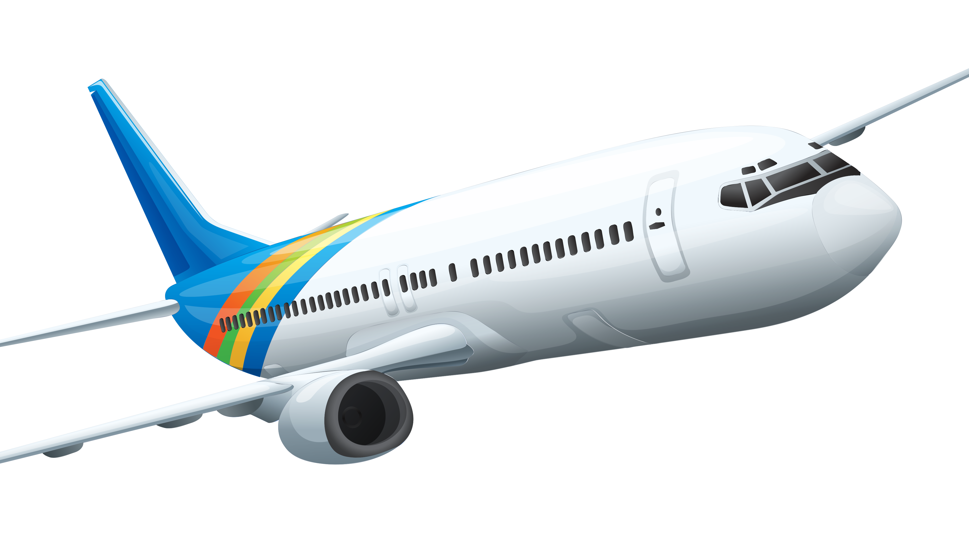
Let’s Fly to details

